Slide 1
2024-25 BIE Interim Assessment
Pre-Administration Training
September 19th & 27th, 2024

Slide 2
Welcome
On behalf of the BIE CAO Assessment Team-
Welcome to the BIE & Pearson Interim Pre-Administration Training for English Language Arts (ELA) and Mathematics.
Our Presenter from Pearson: Sam Boyle

Slide 3
Webinar Norms
Please type your name, email, role, and school in the chat box.
Today’s training will be recorded and posted along with this PPT presentation to https://bie.mypearsonsupport.com/.
Please be sure to mute your microphone, if applicable.
Questions should be posted in the Q&A.

Slide 4
Meeting Purpose & Outcome
Purpose: To assist schools with implementing the Interim assessments.
Outcome: School Test Coordinators will be equipped to implement and assist in the administration of Interim assessments.

Slide 5
Agenda
Interim Assessments Overview
Administration
Before Testing
During Testing
After Testing
Resources
Support Contacts

Slide 6
Interim Assessment Overview

Slide 7
Tested Grades and Subjects
Mathematics
ELA/Literacy
Grades 3-8
Algebra I
Geometry
Algebra II
Grades 3-8
Grade 11

Slide 8
Mathematics Overview
Three unique test forms per grade/course, each administered once during the school year.
Test Forms (Online and Paper):
Aligned to the Mathematics scope and sequence currently implemented across BIE schools.
10−18 test items, depending on grade level/content area.
Single unit divided into 2 sections completed within one instructional period of 45−60 minutes.
Machine-scored and hand-scored items.
Mathematics
Grades 3-8
Algebra I
Geometry
Algebra II

Slide 9
ELA/Literacy Overview
Two unique test forms per grade, each administered once during the school year.
Test Forms (Online and Paper):
Assesses complex text at a higher level of rigor.
12−17 test items, depending on grade level/content area.
Single unit completed within one instructional period of 45−90 minutes.
Machine-scored and hand-scored items.
ELA/Literacy
Grades 3-8
Grade 11

Slide 10
Administration Windows
 | ELA | Mathematics
Frequency | 2x a Year | 3x a Year
Testing Time | Interim 1: 60 mins. max Interim 2: 90 mins. max | All tests: 60 mins. max
Tested Grade/Course | Grades 3−8, 11 | Grades 3−8, Algebra I & II, Geometry
Testing Window | Interim 1: Oct. 28 - Dec. 20, 2024 Interim 2: Jan. 28 - Mar. 7, 2025 | Interim 1: Oct. 7 - Nov. 1, 2024 Interim 2: Nov. 11 - Dec. 20, 2024 Interim 3: Feb. 3 - Mar. 7, 2025
Each school should determine the appropriate time within the administration window to test for each Interim assessment.

Slide 11
Key Dates
ELA
Testing Window | October 28 - December 20, 2024 | January 28 - March 7, 2025
Online Reports Posted | 11/4/2024 | 2/4/2025
Mathematics
Testing Window | October 7 - November 1, 2024 | November 11 - December 20, 2024 | February 3 - March 7, 2025
Online Reports Posted | 10/14/2024 | 11/18/2024 | 2/10/2025

Slide 12
Format and Delivery Mode
Standard form: Online test forms
Accommodated versions:
Text-to-Speech (TTS) forms available for all Math forms.
No TTS forms available for ELA/Literacy forms.
Paper-test forms available to download locally for both ELA and Math (all grade levels/content areas).
Delivery mode: Administered in-person (at the student’s brick-and-mortar school).

Slide 13
Online Readiness
Format:
Standard form: Online assessments
Accommodated versions:
Text-to-speech form available for Math only.
Paper tests for both ELA/Literacy and Math (downloadable PDFs in ADAM).
Mode:
Administered in-person (at the student’s brick-and-mortar school).
Devices:
Educators administer and monitor the assessments through the ADAM platform using computers or laptop devices.
Students access the assessments online through the TestNav App, using Chromebooks and laptop devices.
ELA/Literacy assessments may contain audio components, for this reason all students participating in ELA/Literacy assessments should have access to headphones.

Slide 14
Administration

Slide 15
Administration Agenda
Before Testing
LaunchPad
ADAM
Users
Students
Proctor groups
During Testing
Session management
After Testing
Clean-up activities
Reports

Slide 16
Before Testing

Slide 17
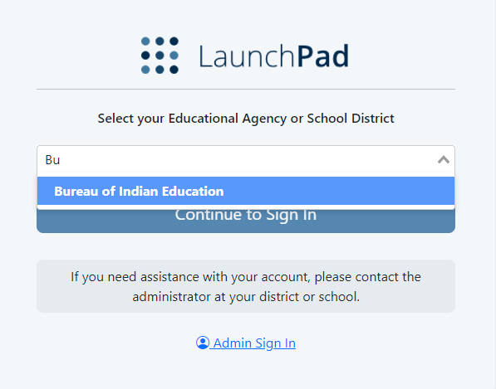
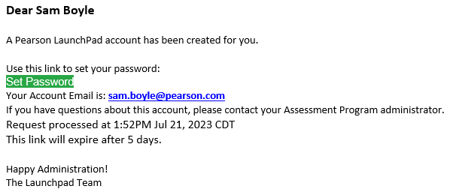
LaunchPad
LaunchPad is the single sign on (SSO) for all Pearson testing products used by the BIE. A welcome email from LaunchPad System will be sent to IT staff, School Admins, & Test Coordinators with a link to set a password.

Slide 18
LaunchPad
Once logged in to LaunchPad, select the ADAM tile from the available apps. Once selected you will automatically be logged into ADAM.

Slide 19
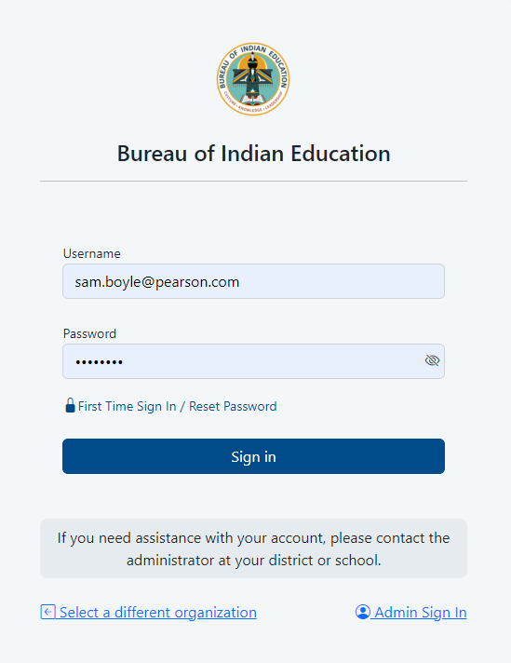
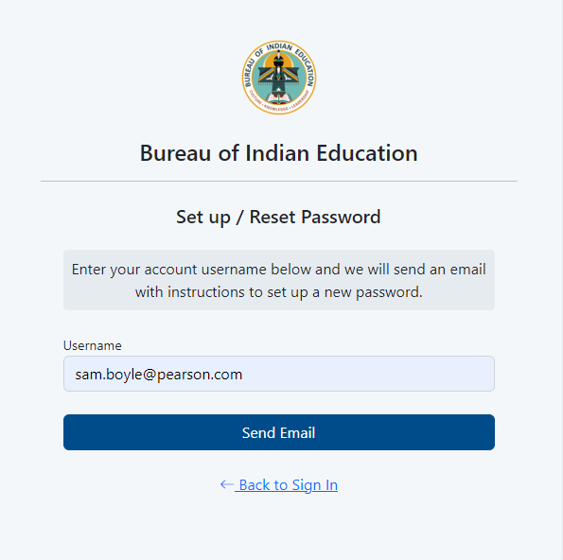
LaunchPad – Forgot Password
If you are having issues logging in use the forgot password link to reset it.

Slide 20
Accessing the Platform
Users can easily access ADAM via the LaunchPad SSO link at https://bie.mypearsonsupport.com.

Slide 21
ADAM
ADAM is the test management platform used to administer Interim Assessments.
ADAM allows users access to the Interim and Training administrations and is also used to create proctor groups and print student test tickets, which students will use to login into the assessment application TestNav.
ADAM is also the platform for accessing student assessment results and reports. More information on results and reporting will be provided later in the training.

Slide 22
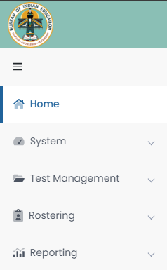
ADAM Menu
Home – Main landing page where Bulletins, including announcements, will be posted.
System – User Profile information can be accessed here.
Test Management – Available test administrations & practice tests can be accessed and administered here.
Rostering – User information can be accessed here.
Reporting – Available reports can be viewed and downloaded here.

Slide 23
ADAM – Users- Users
User Roles
Verifying users
Rostering

Slide 24
User Roles
School Admin – principal and/or assistance principal
Test Coordinator
Information Technology
*Teacher – Proctor in ADAM
*Test Administrator – Proctor in ADAM
*NOTE: Any User that administers tests to students in ADAM is considered a proctor. An active User role in ADAM is not required to proctor/administer a test, only a valid Test Code and Proctor Password provided by the school Test Coordinator. Staff proctoring a test in ADAM will use the credentials provided by their Test Coordinator to login at https://ltr.adamexam.com/#/proctor.

Slide 25
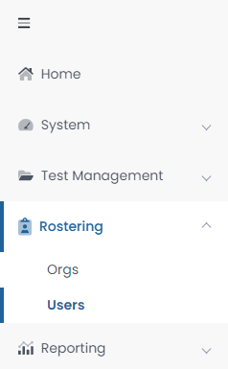
Verifying Users
Click on Rostering in the menu then click Users and you will see a list of users, email addresses, and last login status in your organization.
If a user’s last login status shows Never, that means they have not yet accessed the platform. If any current staff do not have access to ADAM or if any former staff that no longer serve BIE schools still have active User accounts, please contact the BIE.

Slide 26
Rostering in ADAM
Beginning with the 2024-25 school year, roster data will be loaded automatically into ADAM through LaunchPad. All Student User information will be pulled from NASIS through an application programming interface (API).
These API roster imports will include:
New students.
Student transfers (school to school or district to district).
Data updates (DOB, name, demographic information).
Accommodations will not be updated via roster imports, it is the responsibility of the school Test Coordinator to update accommodations in ADAM.

Slide 27
Rostering in ADAM – API Setup
Each school will need to set up an individual API connection between your NASIS/Infinite Campus instance and LaunchPad to initiate rostering between LaunchPad and ADAM. With this API connection in place roster data will flow automatically. Any updates made in NASIS will automatically update in ADAM within 24 hours.
Once completed, this API will remain in place for Spring Summative 2025.
Step-by-step instructions for setting up this API connection can be found at https://bie.mypearsonsupport.com/technology-setup/.
NOTE: Students will not be available in ADAM until the API setup is completed by the school and until Pearson has configured the API to begin passing roster data from NASIS to LaunchPad to ADAM.

Slide 28
Rostering in ADAM – Classes
With the API between NASIS & LaunchPad in place, class enrollment data in NASIS will be passed automatically to LaunchPad and then to both Navvy & ADAM.
This class enrollment data will enable class-level reports under Performance Report for Interim tests.
NOTE: Class setup in NASIS is not a requirement for Interim testing. This is strictly optional to allow class-level reporting to be available in ADAM.

Slide 29
Before Testing – Students
Student Data
Student details
Accommodations and Accessibility
Adding & verifying accommodations
Paper testers

Slide 30
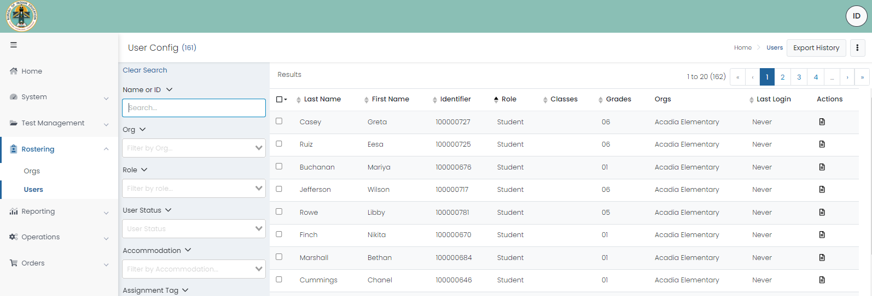
View Roster Data

Slide 31
ADAM – Students
Viewing Student Demographics
On the Users screen, you will be able to view the list of Students uploaded to ADAM. Select Read Only under actions to view the User Setup.

Slide 32
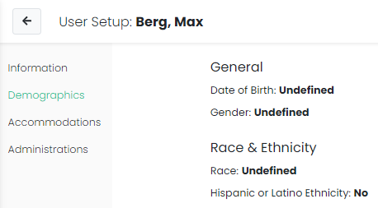
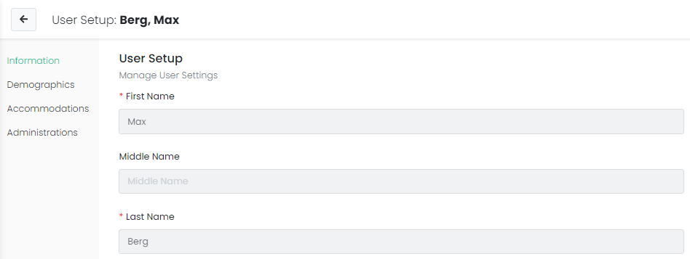
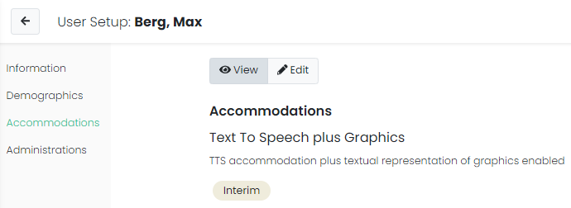
Student User Setup Page
Those with the Test Coordinator role will have access to student details and can use the User Setup screen to view demographic information and both verify and update accommodations.

Slide 33
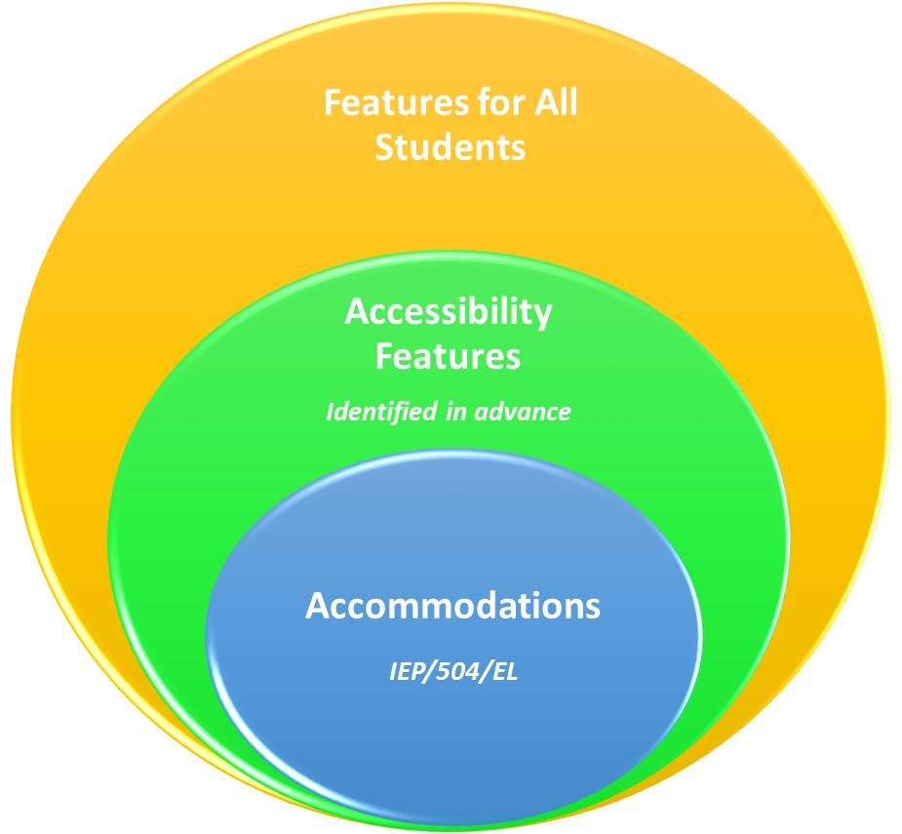
Accommodations & Accessibility Features
Features for All Students
TestNav tools available to all students
Administration Considerations
Testing environment
Accessibility Features
Answer mask / color contrast
Accommodations
Requires IEP/504 or EL plan
NOTE: Student accommodations must be in place before students begin testing. Test Coordinators will need to confirm that the correct accommodations have been applied to the students’ personal needs profile by viewing the Users page in ADAM.

Slide 34
Accommodations & Accessibility Features
Accessibility Feature examples (TestNav):
Line Reader
Answer Eliminator
Magnifier
Highlighter
Bookmark
Pop-up glossary
Notepad
Blank scratch paper
NOTE: No IEP/504/EL plan required

Slide 35
Accommodations & Accessibility Features
Administration Consideration examples:
Special Equipment or Furniture
Frequent Breaks
Small Group Testing
Specified Area Setting
Separate or Alternate Testing Location
Time of Day
NOTE: No IEP/504/EL plan required.

Slide 36
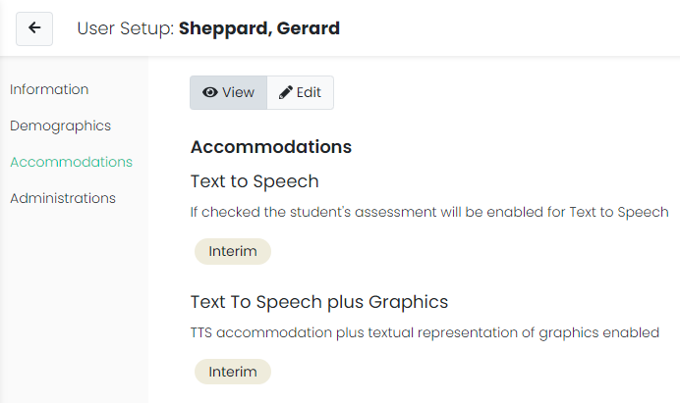
Accommodations & Accessibility Features
Accommodation form specific examples:
Assistance with Testing
Text to Speech & Text to Speech plus Graphics (Math)
Presentation Accommodations
Paper test (ELA & Math)
NOTE: If a student begins a test with an incorrect test form assigned, the student should exit the test and the accommodation should be updated on the User record. Then the proctor can reseat the student and let them log back into the test using the same test code and credentials.

Slide 37
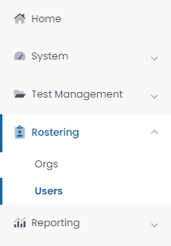
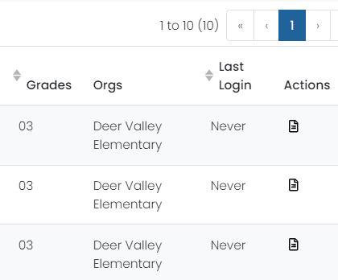
Assigning Accommodations
School Test Coordinators will be responsible for applying student accommodations prior to testing. Accommodations can be applied to the Student record directly or in bulk via a data import using the Student Accommodation Upload option.

Slide 38
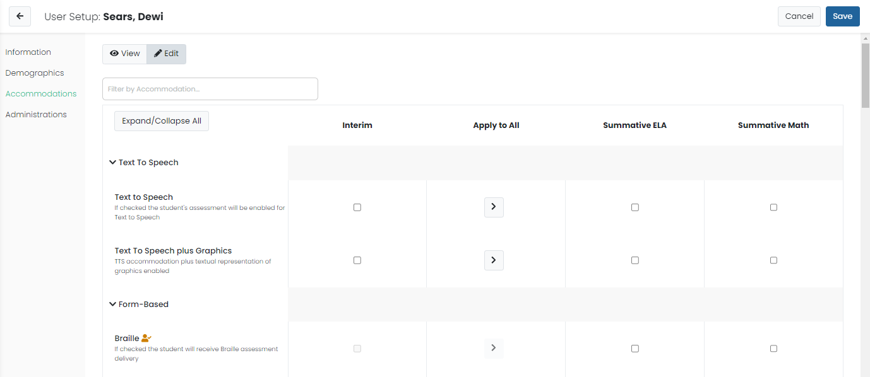
Assigning Accommodations

Slide 39
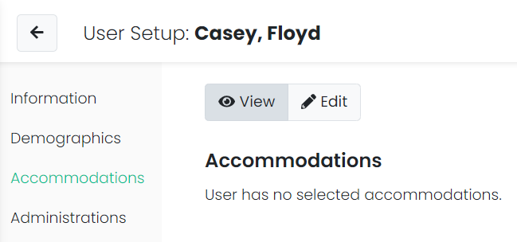
Student Accommodations
When viewing Student accommodations, a summary of the accommodations currently assigned will display, including the administration they are assigned to. If no accommodations are applied, this will be indicated.

Slide 40
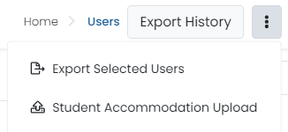
Student Accommodation Upload in ADAM
Select Rostering, then select Users.
Search for the students you want to view or update (set the Role filter to "Students"). You can search for all the students in a school or a single grade.
Select the checkbox in front of each student you want to update. You can select the checkbox at the top of the list to select all students in the search results or on the current page.
Select the ellipses on the top right, then select Student Accommodation Upload.
Follow the on-screen instructions on the Student Accommodation Upload and Update Students via CSV page.

Slide 41
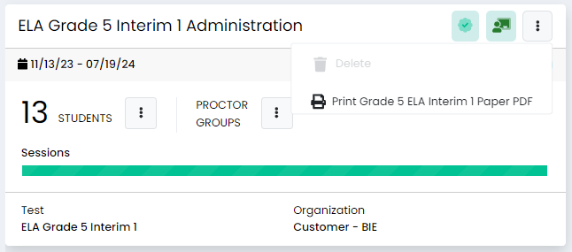
Paper Accommodation
To administer the test for a student with a paper accommodation:
Verify that the student has Paper assigned as an accommodation in ADAM.
Navigate to the Admin card or the proctor dashboard.
Select the option to download and print the paper test booklet PDF.
Allow the student to test, marking their answers in the test booklet.
Log-in to TestNav using the information on the student test ticket.
Transcribe the student’s answers into TestNav.
Submit the test for scoring.

Slide 42
Before Testing – Proctor Groups
Test Administrations
Creating Proctor Groups
Adding students
Printing Student Test Tickets

Slide 43
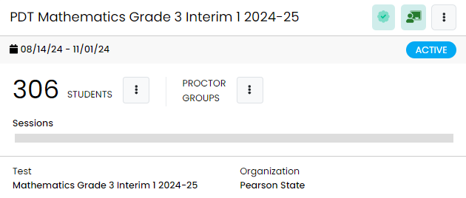
Test Administrations in ADAM
BIE School Admins & School Test Coordinators will be able to view test administrations in ADAM.
Administrations in ADAM feature three sections:
Students – a list of all eligible students for a particular test.
Proctor Groups – to view or create testing groups.
Sessions – to view student progress.

Slide 44
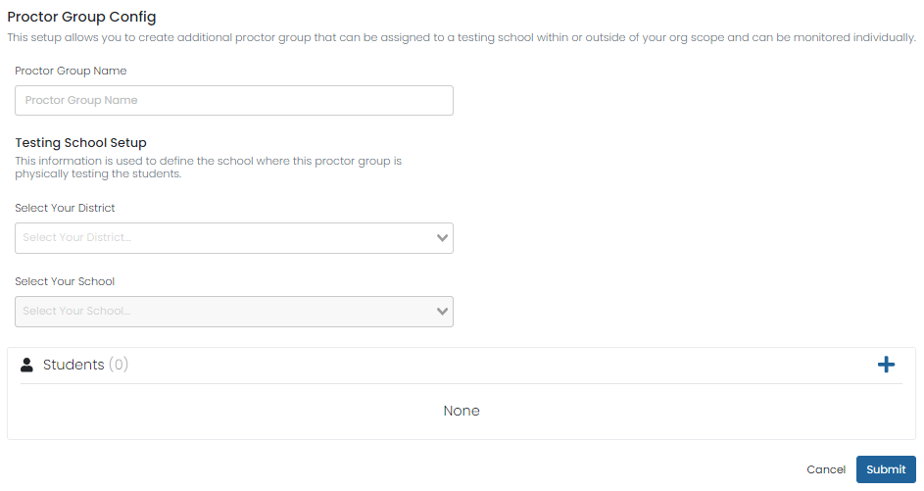
Creating Proctor Groups
When you first open View Proctor Groups all students will be assigned to an Unassigned proctor group automatically.
To create your proctor group:
Select Create Proctor Group.
Complete the form for each proctor group you are creating.
To assign students, click the + button and then select students to assign to the proctor group.
Click Submit to save the new proctor group.
Once your proctor group(s) are created the test coordinator will then provide each proctor with their unique Test Code and Proctor Password.

Slide 45
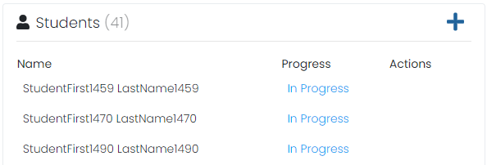
Adding Students to Existing Proctor Groups
Go to Test Management > Administrations.
In the appropriate administration card, select View under Proctor Groups.
Select Students under Actions.
Select Edit Proctor Group.
Select the + icon to assign additional students.
NOTE: Students can also be removed from a proctor group if they have not logged into TestNav.
45

Slide 46
Student Registration
Go to Test Management > Administrations.
On each Administration card it will show the total registered student count for that test.

Slide 47
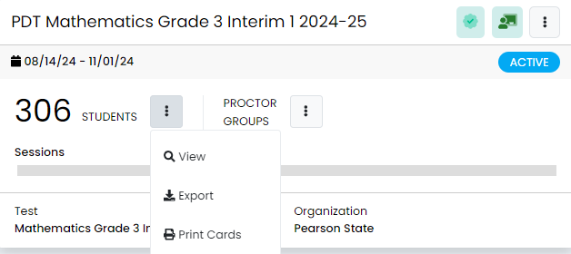
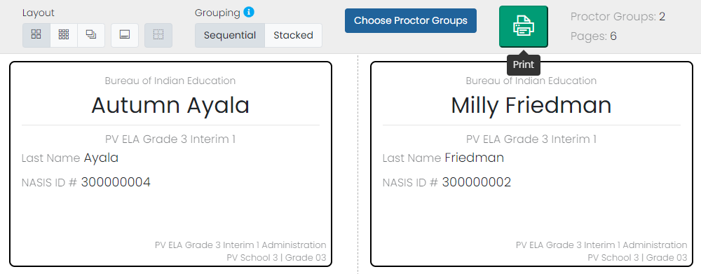
Printing Test Cards
Locate the administration card, select Students, then select Print Cards.
You can select various formatting options:
Layout - Select 2 by 4, 3 by 6, or 1 per page.
Toggle title pages for each proctor group - Select whether to include title pages for each proctor group. This prints a roster for the proctor.
Toggle borders - Select whether to include dashed borders (guides for cutting the cards).
Grouping - Sequential or Stacked. Select the information icon to see formatting conventions for each option.
Choose Proctor Groups - Select the proctor groups you want to print.
Select the Print button.

Slide 48
Test Coordinator Tasks – Before Testing
Verify and update student accommodations in ADAM.
Collect Chromebooks, laptops, and headsets 3−5 days prior to test administration, for maintenance and charging.
Confirm that the TestNav App on Chromebooks and laptops has been properly configured, updated, and is ready for student testing. TestNav can be downloaded here: https://support.assessment.pearson.com/TN/download-testnav-57082522.html
Ensure students have practiced with practice tests and available tutorials.

Slide 49
Test Coordinator Tasks – Before Testing
Review the Test Administrator Manual: https://bie.mypearsonsupport.com/interim-resources/
Provide training for teachers and staff on testing and testing expectations.
Print & distribute student test tickets & distribute login credentials to all proctors.

Slide 50
During Testing

Slide 51
During Testing
Proctoring & Monitoring
Proctor dashboard
Student session statuses
TestNav

Slide 52
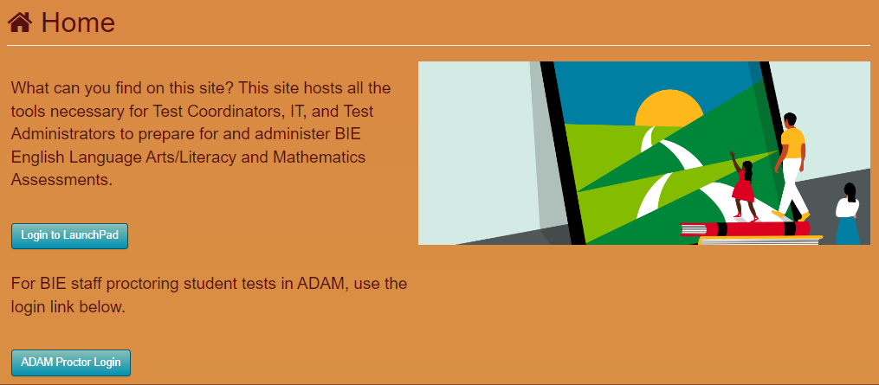
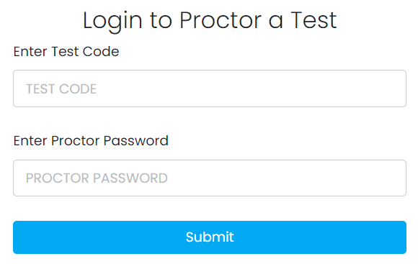
Proctor Login
Navigate to https://bie.mypearsonsupport.com/ and select ADAM Proctor Login or https://ltr.adamexam.com/#/proctor.
Enter the Test Code & Proctor Password (provided by the Test Coordinator).
Select Submit.

Slide 53
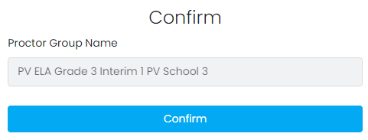
Proctor Login
Select Confirm on the next screen.
Type first name & last name.
Select Save.
Proctor dashboard will then load.

Slide 54
ADAM Proctor Dashboard

Slide 55
Proctor Dashboard Details
Assessment Information – Here you can view information about the test, test configuration, and select an action.
Testing Information – Includes Test, Administration, and Proctor Group
Config Information – Includes Test Window, Proctor Name, and Kiosk Only field
Actions – Includes Test Code, Proctor Password, and Print Cards link
Student Session List – Here you can view, filter, and search for students in your proctor group and manage their sessions. Students that can access the test appear in the Tester column.

Slide 56
Temporary Student Records
If a student enrolled at your school does not have a record in ADAM, a temporary record can be created in the proctor dashboard.
A temporary record will need to be created for each test the student takes.
When creating a temporary record, a unique ID will need to be applied.
Pearson recommends using the student’s NASIS ID + a unique identifier (i.e. NASIS ID – 123456789 + Interim1Math).
Once a permanent record has been created in ADAM for the student, all temporary records will need to be merged to the permanent record for the test to be scored and reported.

Slide 57
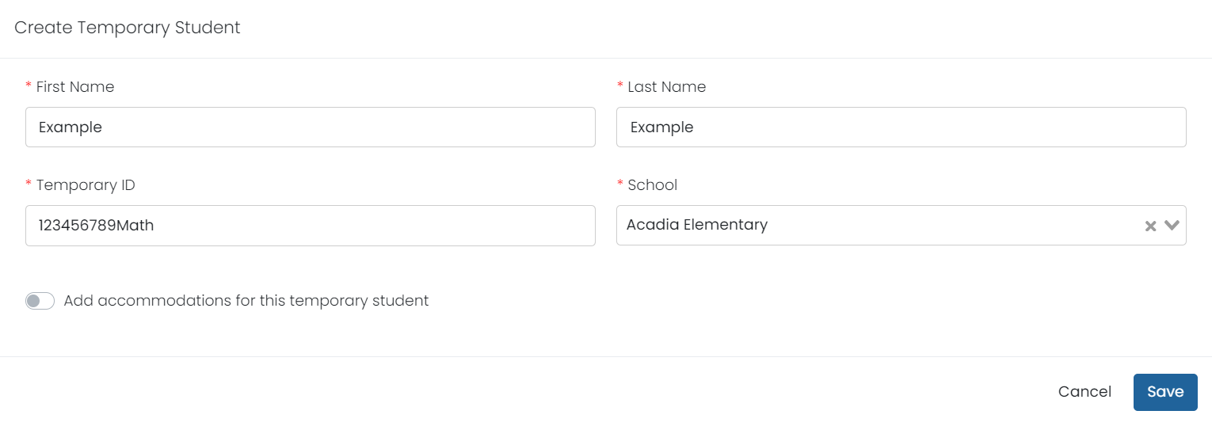
Creating Temporary Students
To create a temporary student record in ADAM:
Navigate to the proctor dashboard where the student will test.
Select Create Temporary Student
Add the students First Name, Last Name, Temporary ID, and School.
If applicable, select Add accommodations for this temporary student and add all needed accommodations.
Select Save.

Slide 58
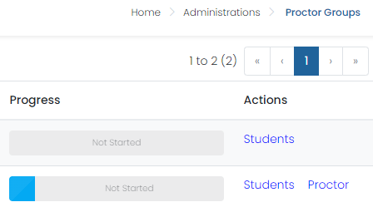
Monitoring Proctor Groups
School Test Coordinators can monitor student testing statuses or proctor tests by selecting View under Proctor Groups on the admin card, then selecting Proctor under Actions for a particular proctor group. This will take you to the proctor dashboard for that proctor group.

Slide 59
During Testing – Progress
The progress column displays the students’ progress as one of the following:
Not Started – The student has not signed in to test.
Needs Attention – The student has logged into TestNav and needs their test approved by the proctor.
In Progress - The student has signed in to the test. No action is needed by the proctor.
Submitted - The student has completed the test and submitted their answers.
Reseat – The proctor has reseated the student(s). The student has not yet signed back in to the session. No action is needed by the proctor.

Slide 60
During Testing – Health
Health tells the proctor if the student is interacting with the test. Health can display one of the following values:
Not Started – The student has not signed in to the test. No action is needed by the proctor.
Submitted - The student has completed the test and submitted their answers.
Exited - The student has exited TestNav, and a proctor must reseat them before they can log in to the test again.
Resumed – The student has resumed their test session.

Slide 61
During Testing – Actions
After the assessment session has started, a set of buttons appears in the Actions column for each student. Proctors use these buttons to control individual student’s sessions:
Approve Session – Proctors will need to select Approve Session for any student with a Needs Attention progress status for the student to begin their test in TestNav.
Reseat Session – Proctors can select this if a student exits TestNav before submitting their test or if something interrupts a student's session. This might include a computer issue, session timeout, or an unexpected error. Reseating allows the student to re-enter their test code and SSID to continue taking their test.
Submit Session – Test Coordinators can select this if a student finishes their test but fails to submit the test before exiting.
Unsubmit Session – Test Coordinators can select this if a student mistakenly submits their test.

Slide 62
Test Coordinator Tasks – Day of Testing
Complete the Day of Testing Checklist:
Distribute test materials.
Ensure Test Administrators have a computer device to administer the test & can access the ADAM proctor dashboard.
Monitor test activity.
Be available to Test Administrators.
Collect materials from Test Administrators after each test, as needed.

Slide 63
Test Administrator Tasks – Day of Testing
Prepare the test environment and situate the students.
Follow directions and read the script in the Test Administrator Manual (TAM) to initiate the test proctor group.
Hand out test tickets and scratch paper when directed (per the TAM script).
Assist students in logging into TestNav.
Collect student test tickets and scratch paper.
Confirm students have submitted their tests and logged out of TestNav.
Confirm ALL tests are “Submitted” status.

Slide 64
Test Administration During Testing – Active Monitoring
Test Administrators/Teachers Should:
Ensure students have all necessary materials for each test.
Follow test administration scripts exactly as written.
Move throughout the room during testing to ensure students are on task.
Test Administrators May Not:
Provide feedback or clarify test questions.
Answer content related questions.
Interact with students in any way that would impact student responses.

Slide 65
Test Administration During Testing – Electronic Devices
ALL personal electronic equipment not related to testing (e.g., cell phones, iPods, personal document scanners, eBooks, electronic pens, smart watches, etc.) are PROHIBITED from the testing environment.
Personal electronic equipment may not be used at any time during testing, including after a student has completed testing or during a break.

Slide 66
Test Administration – Early Finishers
Materials allowed ONLY AFTER a student’s test has been submitted and after their secure materials have been collected:
Recreational books (subject matter of recreational books must be unrelated to content being assessed).
Instructions for students AFTER a student’s test has been submitted and their secure materials have been collected:
After the student has checked his or her work, the student may sit quietly until the testing unit has ended.
After the student has checked his or her work, the student may be permitted to read silently a recreational book (see above).
If two units are scheduled, these instructions may be applied after the second unit is administered.

Slide 67
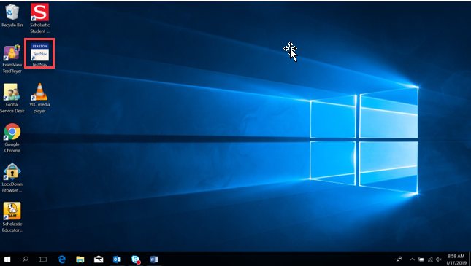
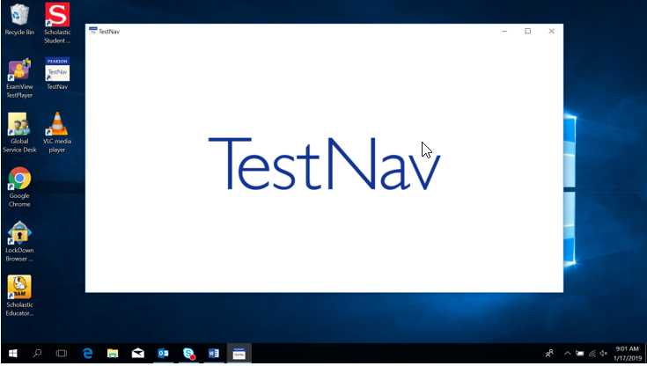
TestNav – Student Access on a Windows device
Select the TestNav icon from the desktop.

Slide 68
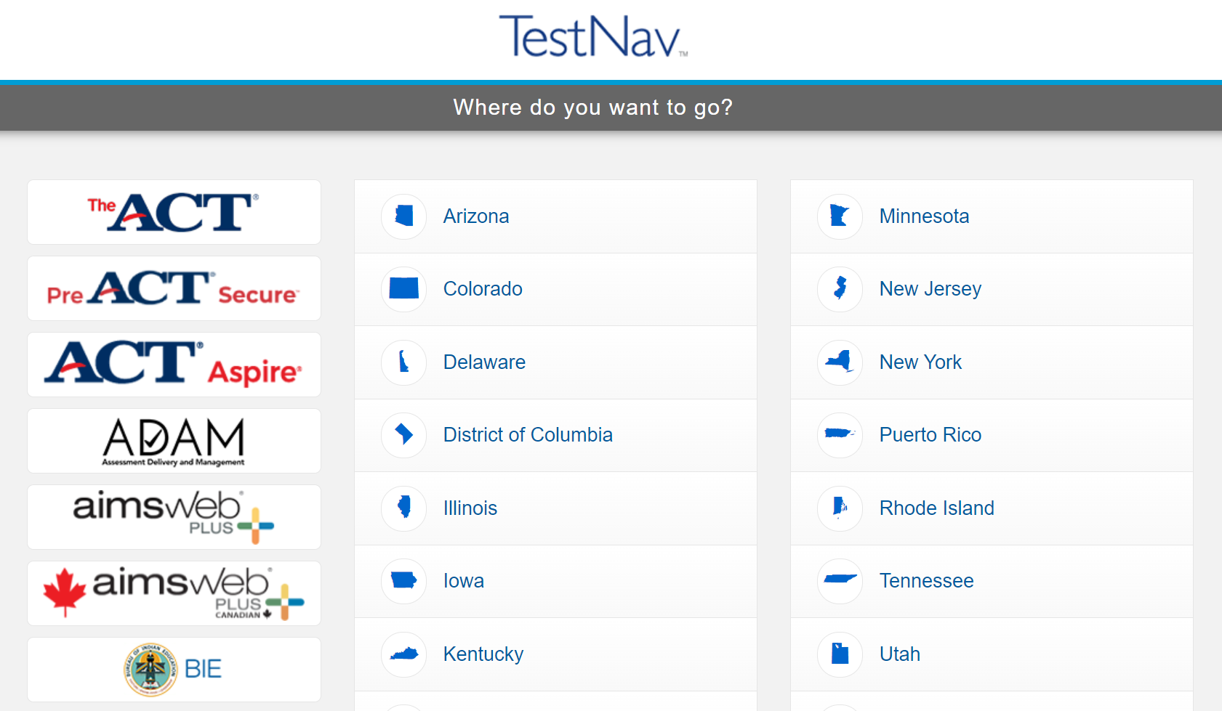
TestNav Access
If not already chosen, students may need to select BIE from the customer list.

Slide 69
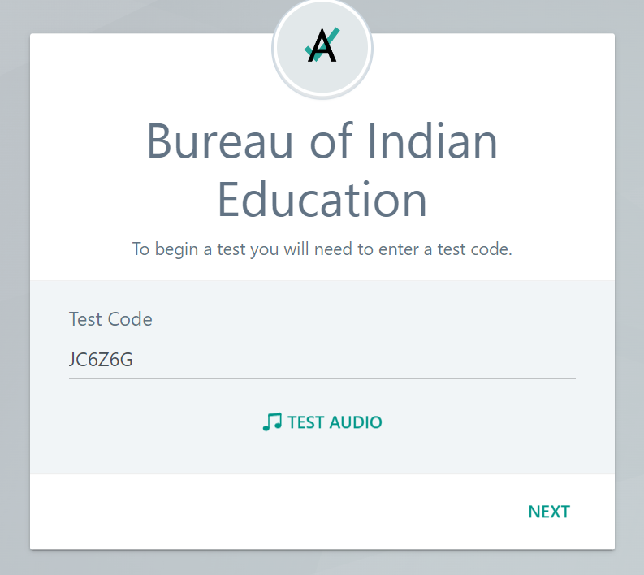
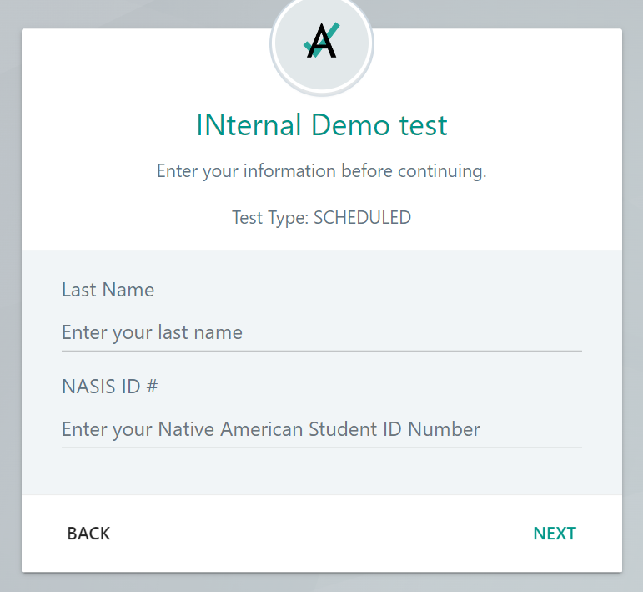
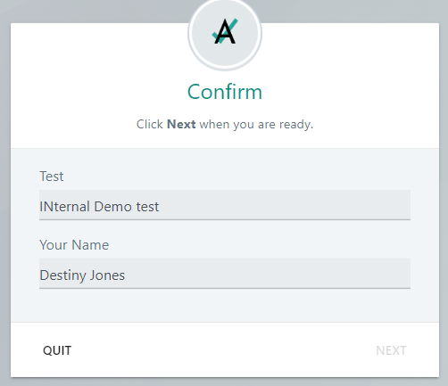
TestNav Sign-In
Students input the Test Code provided by the proctor & Last Name and NASIS ID from their test ticket.

Slide 70
After Testing

Slide 71
After Testing
Computer-based Tasks
Paper-based Tasks
Scoring & Reporting

Slide 72
Computer-based Tasks to Complete After Testing
Ensure all student tests are in a Submitted status in ADAM.
Manually Submit Session for any student who finished their test but did not submit the test in TestNav before exiting.

Slide 73
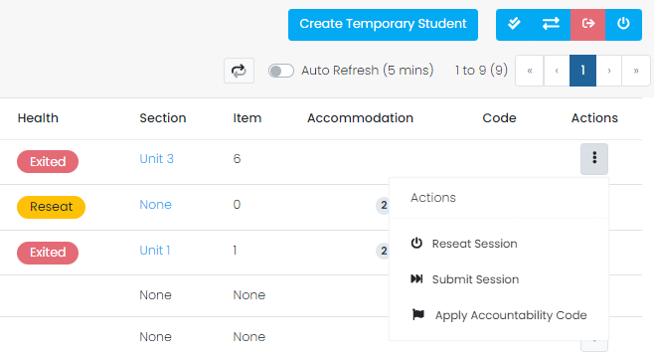
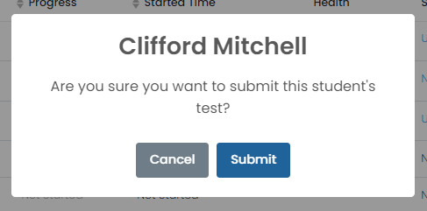
Manually Submitting Test Sessions – Proctor Dashboard
To manually submit a student’s test session in ADAM:
Navigate to the appropriate proctor dashboard for the student(s) needing to be submitted.
Any student that is still In Progress and has a Health of Reseat can have their test submitted.
Under Actions select the ellipses, then select Submit Session. In the pop-up window confirm by selecting Submit.

Slide 74
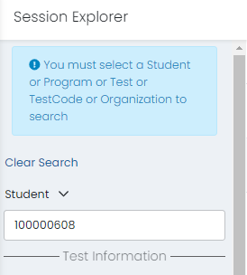
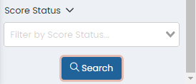
Manually Submitting Test Sessions – Session Explorer
To manually submit a student’s test session in ADAM:
Navigate to Operations, then Session Explorer.
Enter the appropriate student ID in the Student search option, then select Search.
Under Actions select the ellipses, then select Submit Session. In the pop-up window confirm by selecting Submit.

Slide 75
Paper-based Tasks to Complete After Testing
Transcription Guidelines:
The Test Administrator shall transcribe the student responses into TestNav.
The student’s responses must be transcribed verbatim from the Test Booklet.
After transcription, shred any responses on site.

Slide 76
Scoring & Reporting
Scoring:
Interim Assessment items will be machine-scored and hand-scored.
Test Coordinators & School Admins will have access to the test results of students once they are done testing and all constructed-response items have been scored.
Performance Levels:
Above: 75-100% Correct
Meeting: 46-74% Correct
Approaching: 26-45% Correct
Beginning: 0-25% Correct

Slide 77
Interim Administration Reports
The following reports will be available in ADAM:
Activity Report
Performance Report
Individual Student Reports (ISRs)
Item Analysis
Performance Summary
Program Report
Standard Performance
Progress Report
Student-level reports will be available once the student has completed testing and all constructed-response items for their test has been scored.

Slide 78
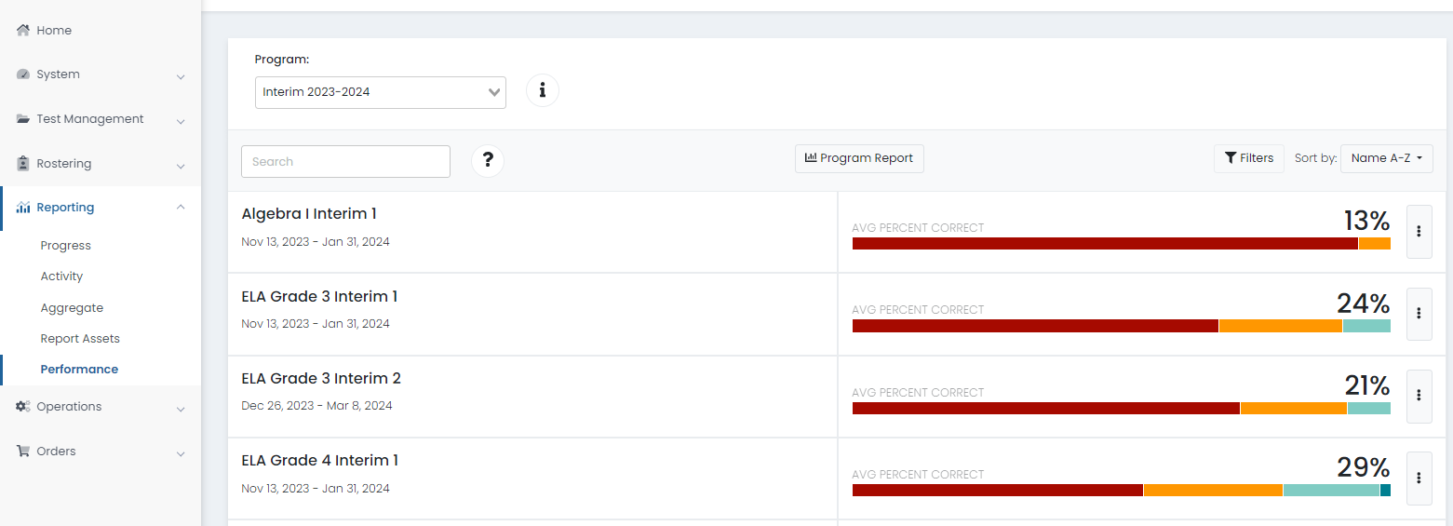
Interim Administration Reports
Reports are accessed via the Reporting link in the left side menu.

Slide 79
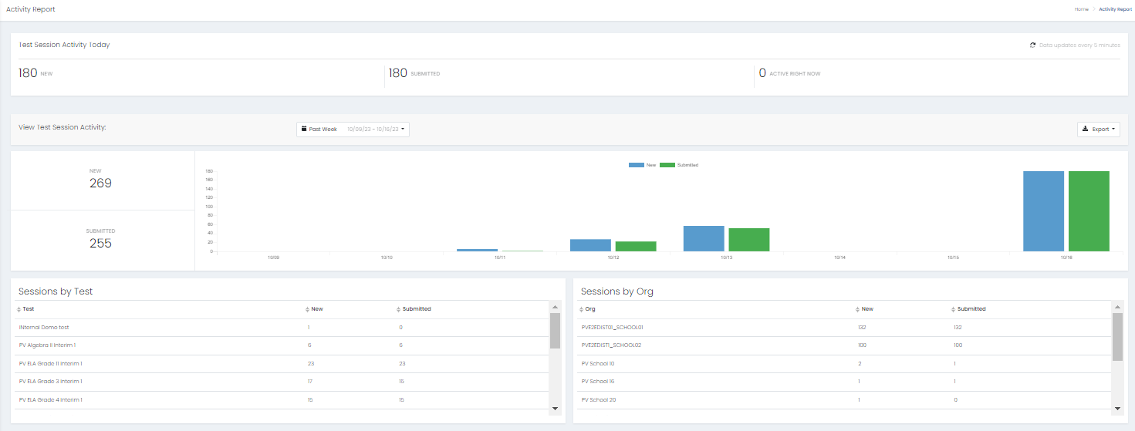
Activity Report
The Activity Report shows the activity on all test administrations over a selected time.

Slide 80
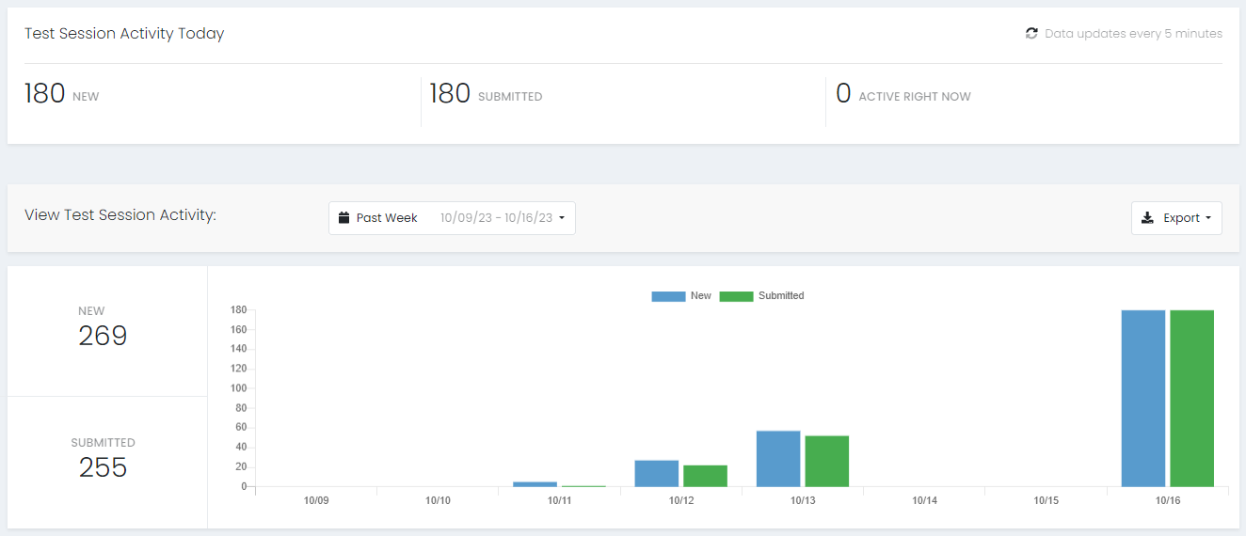
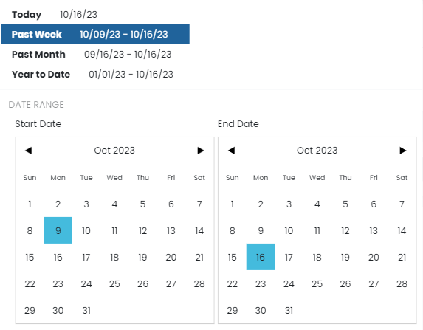
Activity Report
The Activity Report shows the activity on all test administrations over a selected time.

Slide 81
Activity Report
The Activity Report shows the activity on all test administrations over a selected period of time. Sessions can be viewed by Test or by Org.

Slide 82
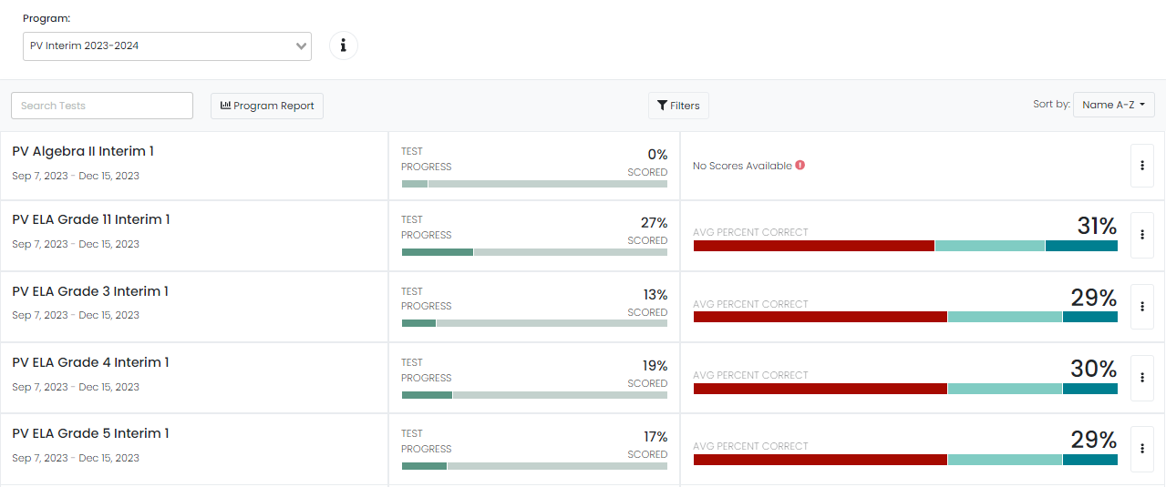
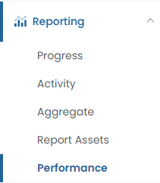
Performance Report
The Performance Report shows student performance for a single test. This report is only available to roles with permission to view it, such as Test Coordinators. The report is dynamic and updated in real time.

Slide 83
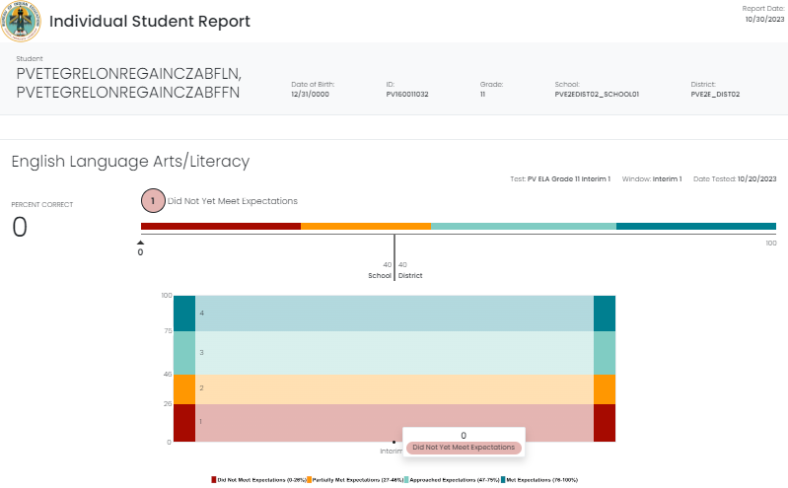
Performance Report – Individual Student Results (ISR) Reports
The Individual Student Results (ISR) Report shows individual student performance across tests windows on tests assigned to a program. If enabled, this report is available to roles with permission to view it.

Slide 84
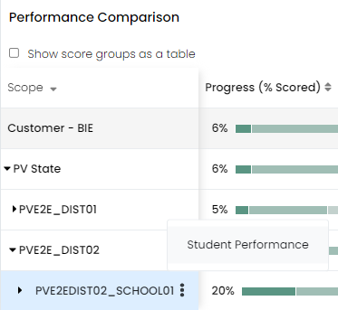
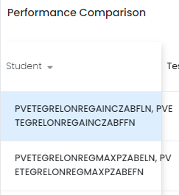
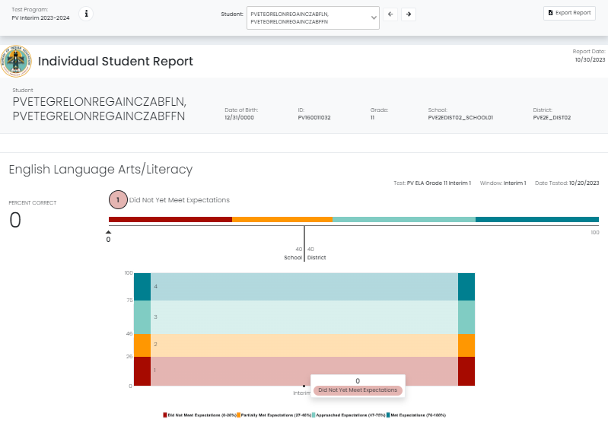
Individual Student Results (ISR) Reports
For Test Coordinators & School Admins:
Select Reporting, then select Performance.
Select anywhere in a test row to open the Performance Summary.
Select the ellipses for your school, then select Student Performance.
Select any student to view their ISR.

Slide 85
Performance Report – Performance Summary
Select Reporting, and then select Performance.
Click anywhere in a test row to open the Performance Report.
The Performance Summary tab provides a performance overview across all organizations you have access to.

Slide 86
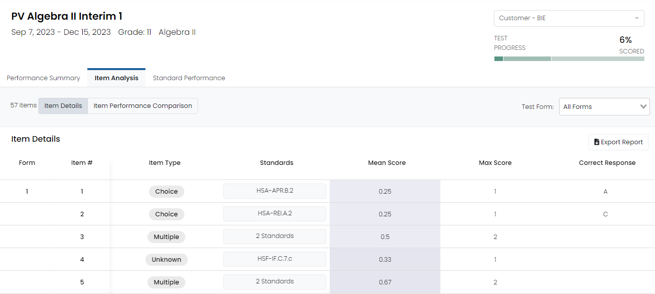
Performance Report – Item Analysis
Select Reporting, and then select Performance.
Click anywhere in a test row to open the Performance Report.
Select Item Analysis.

Slide 87
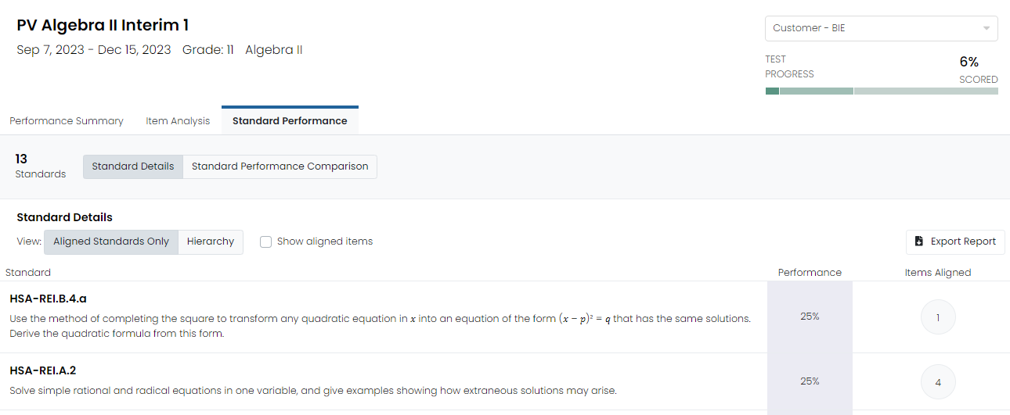
Performance Report – Standard Performance
Select Reporting, and then select Performance.
Click anywhere in a test row to open the Performance Report.
Select Standard Performance.

Slide 88
Performance Report – Program Report
The Program Report provides an overview of student performance for all (or selected) test windows in a program. This report is available to roles with permission to view it, such as school administrators.

Slide 89
Program Report
Select Reporting, and then select Performance.
Select a Program from the dropdown.
Then, select Program Report.

Slide 90
Progress Report
The Progress Report shows the status of a selected test.
Select Reporting, then Progress.
Select a Program and on the Program Overview page, click on an assessment to access the Program Comparison View. The report shows how many students are in a Submitted, In Progress, Not Started, or Exited status.

Slide 91
Progress Report
After selecting an assessment, you’ll see a Progress Comparison review which will show a breakdown of all eligible students in a Submitted, In Progress, Not Started, or Exited status for that test.

Slide 92
Resources

Slide 93
Resources
Non-secure Practice Tests, Test Administrator Manual, documentation, and guides are all available on the BIE customer portal at https://bie.mypearsonsupport.com. Resources specific to the Interim Assessments can be found on the Interim Resources page.
Additional support for ADAM can be found at https://support.assessment.pearson.com/as.

Slide 94
BIE Support Site
If you navigate to the Interim Resources page of the BIE support site at https://bie.mypearsonsupport.com/interim-resources/ you can locate:
Test Administrator Manual (TAM)
Test Administrator scripts
Training videos & training presentation
Additional resources, including:
Math reference sheets
ELA & Math test blueprints
Other useful guides

Slide 95
Customer Support
Contact Pearson Customer Support by Chat, Phone, or Email for:
Navigating ADAM
Creating proctor groups
Managing user IDs and passwords
Accessing resources
1-833-302-9587 Monday - Friday 3:30 am - 4:30 pm (PT) 4:30 am - 5:30 pm (MT) 5:30 am - 6:30 pm (CT) 6:30 am - 7:30 pm (ET)
https://bie.mypearsonsupport.com/support/

Slide 96
End of Presentation
96
Notes:
Closing Slide

